Slide 1
Meeting 2 Where the MAPP Leads: A Foster Care and Adoption Experience

Slide 2
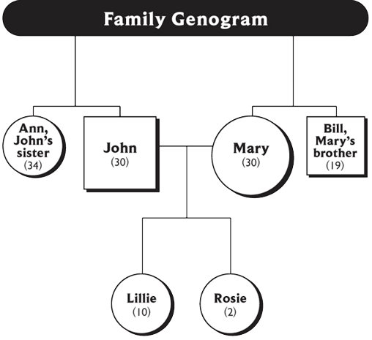

Slide 3
Erikson's Stages of Development*
Young Adulthood
Intimacy vs Isolation
Adolescence
Identity vs Diffusion
Ages 6 – Puberty
Industry vs Inferiority
Ages 3 – 5
Initiative vs Guilt
Ages 2 – 3
Autonomy vs Shame
Birth – Age 2
Trust vs Mistrust
* Erickson, E.H. Childhood and Society, 2d ed. NY: WW Norton, 1963.

Slide 4
Video: The Children are Listening

Slide 5
Assessing Well-Being Needs of Children and Youth: Small Group Directions
Select recorder/reporter
Use case examples and worksheets to continue assessment
After 8 to 10 minutes be ready to share assessment

Slide 6
Roadwork
Complete Strengths/Needs Worksheet and Feedback to the Leader(s) – bring to Meeting 3
Review Meeting 2 handouts
Read Meeting 1, Handout 3
Complete the Profile or schedule your Family Consultation

